Slide 1




PYTHON BASIC
FOR PETROLEUM ENGINEERING
“Data is the new oil”

Slide 2
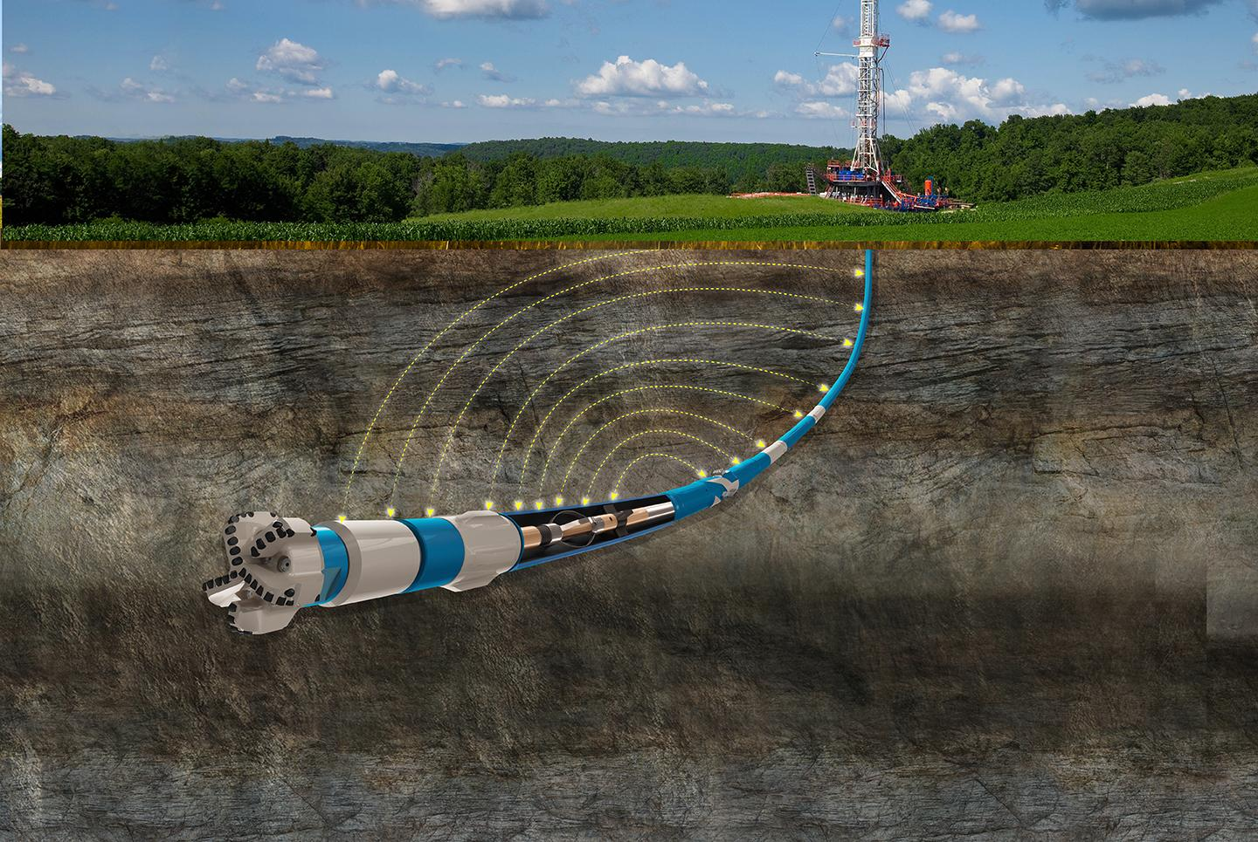
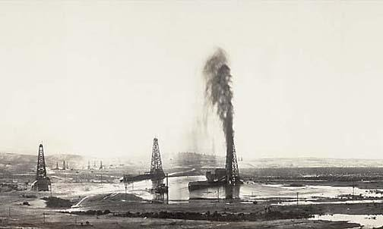
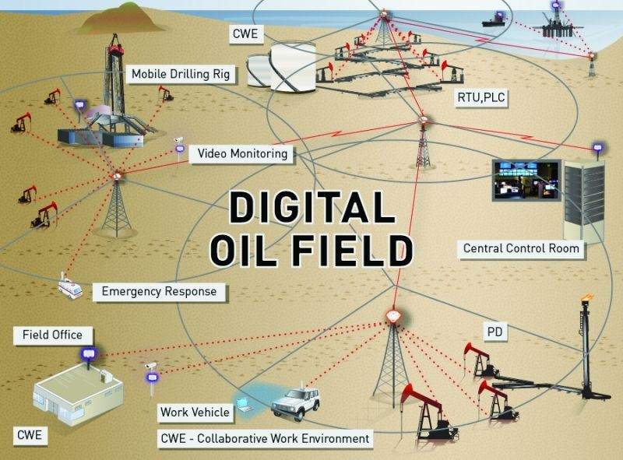
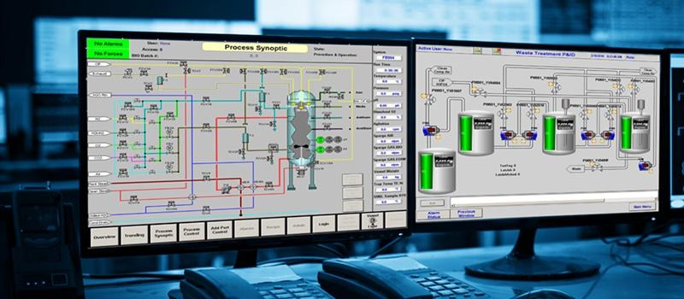
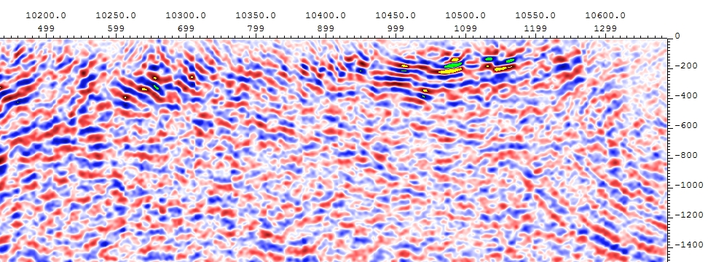

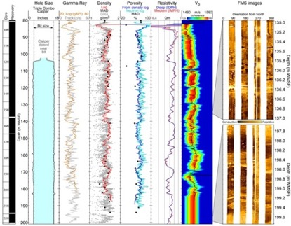
Big Data analytics in the Oil and Gas industry: AN EMERGING TREND
Volume - Variety - Velocity
Veracity - Value
Saputelli et al. (2013) Digital O&G Field #DOF

Slide 3
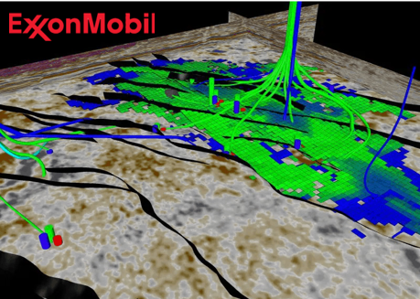

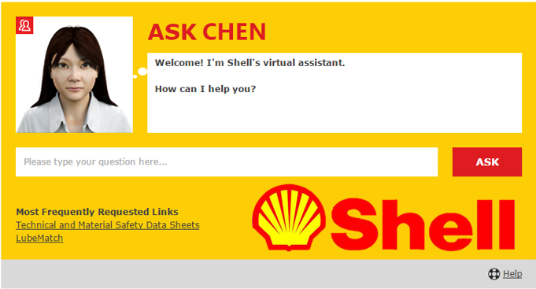

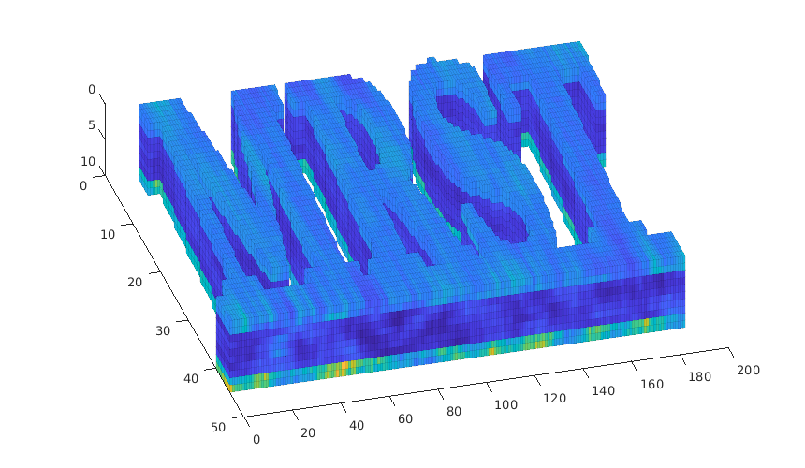



OIL and GAS GIANTS already using BD, ML & AI
SOFTWARE OPEN-SOURCE O&G

Slide 4
PETROLEUM ENGINEERING
DATA ANALYSIS
Feature Engineering
Data Wrangling
EDA
DOMAIN
EXPERTISE
MATH
Statistics
Linear Algebra
Differential Calculus
Scientific
Methods
Processes
DATA
SCIENCE
MATHEMATICS
COMPUTER
SCIENCE
TECHNOLOGIES
Cloud computing
Databases
Systems

Slide 5


MACHINE LEARNING
Real-Time Stuck-Pipe Prediction.
Real-Time ROP (Rate of Penetration) optimization.
Completions and well spacing optimization.
Fault detection through seismic data.
Facies classification and automation, rock typing y lithology.
Virtual Measurements of Permeability.
Generating synthetic Well logs.
SCADA: Real-time and Historical Production.
Predictive maintenance: Real-Time Electric Submersible Pumps (ESP) Failure Prediction.
PROGRAMMING LANGUAGE
R
Julia
PYTHON

Slide 6





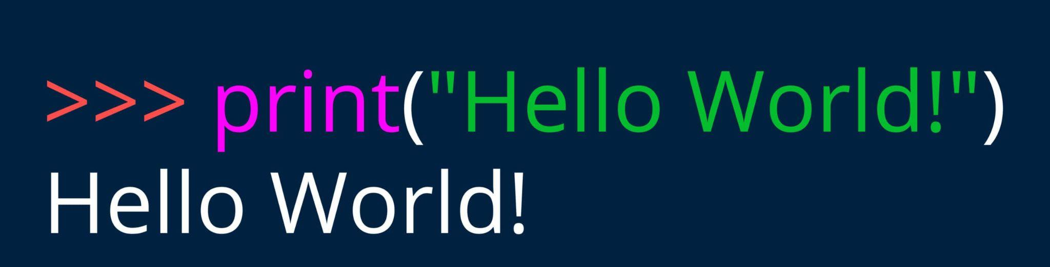
PYTHON
Interpreted programming language
High-level
Open source
Invented in Netherlands, early 90s by Guido van Rossum
Notes:
Interpreted Son lenguajes que se ejecutan linea por linea en un intérprete
High-level se asemejan al lenguaje con el que nos comunicamos

Slide 7








WHY PYTHON?
It is a simple, flexible, and easy to learn programming language
Facilitates the incorporation of non-
programming professionals to the
community of developers and
collaborators
Expands professional
capabilities, particularly
valuable to engineers
and geoscientists
It has an extensive and dynamic user community developing
applications in multiple domain areas, and continues to grow
Especially popular in
data analytics and ML
A Broad ecosystem of open-source scientific libraries (Scipy, NumPy.
SymPy. pandas, matplotlib)
Some industry tools
developed in Python.

Slide 8
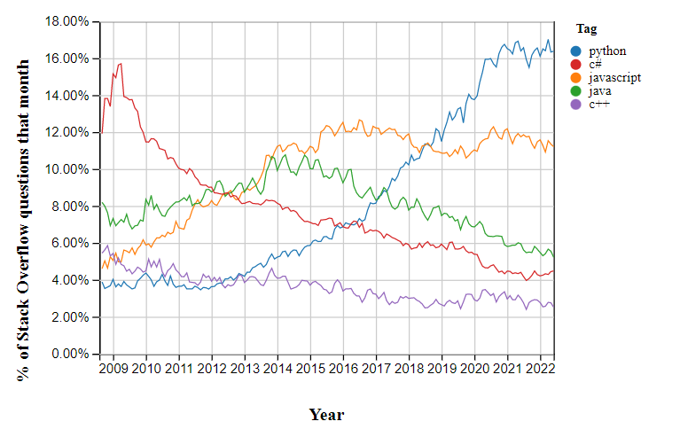
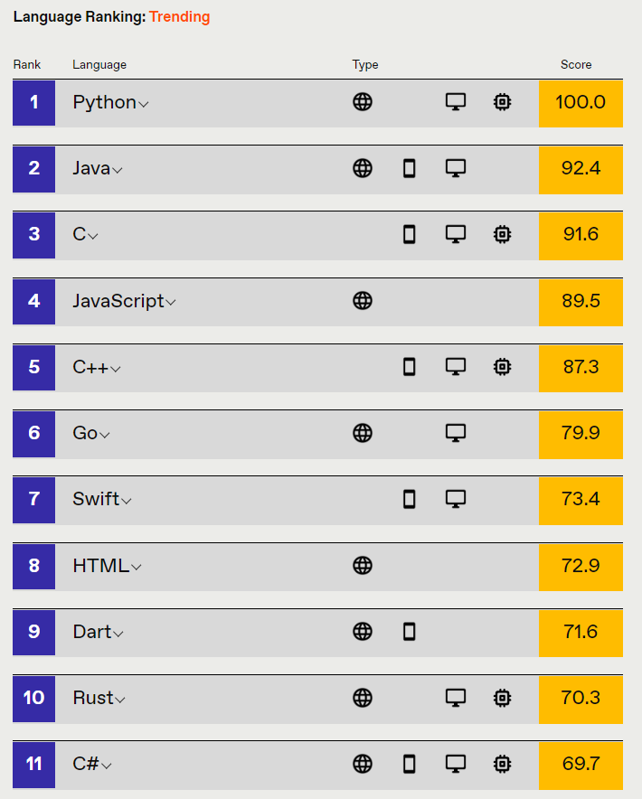
PYTHON
Stack Overflow Trends
Popularity ranking
Source: https://spectrum.ieee.org/top-programming-languages/
Source:
https://insights.stackoverflow.com/trends?tags=python%2Cjavascript%2Cjava%2Cc%23%2Cc%2B%2B
Notes:
ranking de los lenguajes de programación más populares desarrollo Web, aplicaciones de Escritorio, microcontroladores — Stack Overflow es un sitio web muy conocido de preguntas y respuestas para programadores

Slide 9





IDE (Integrated Development Environment) is an application to run Python.

Slide 10



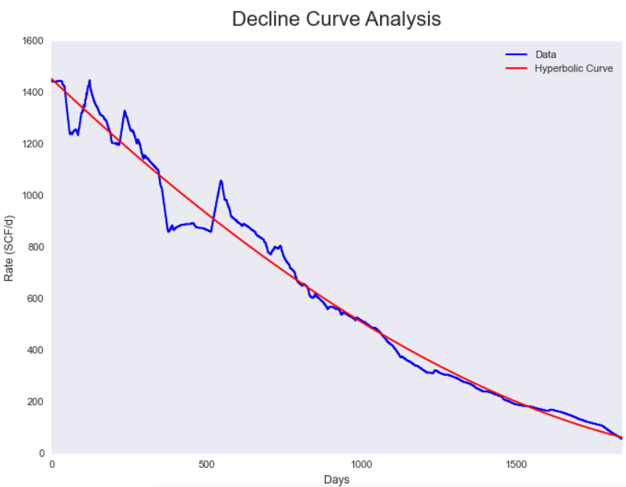
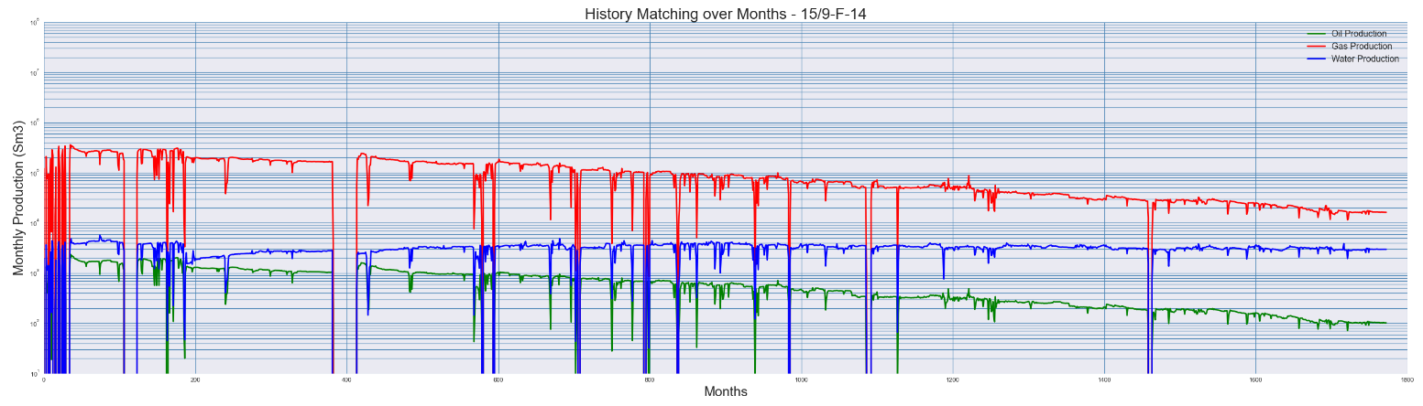
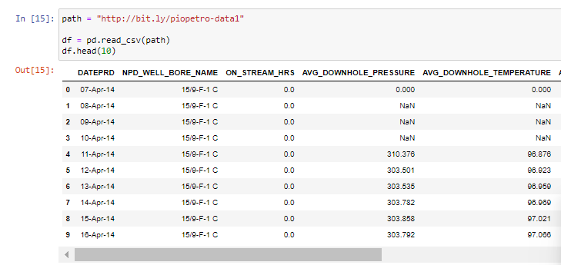
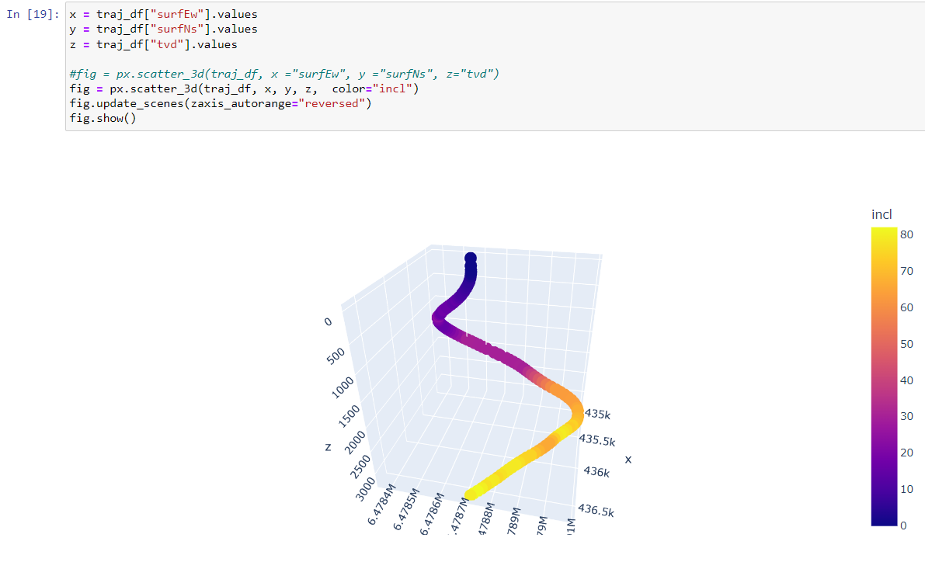
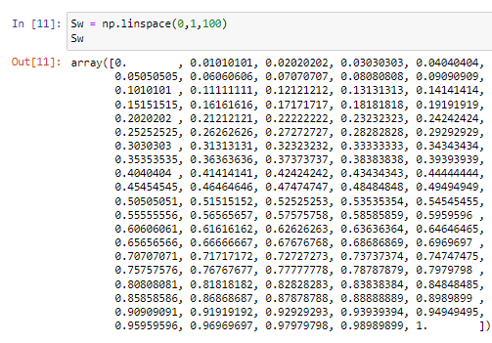


Library: is a collection of files (called modules) that contains functions
Notes:
Numpy es una librería para realizar cálculo numérico en python (vectores, matrices)
Pandas para manipulación y tratamiento de datos
Scipy se usa para resolver problemas cientificos y matematicos (es una extensión de Numpy)
Matplotlib para crear gráficos simples
Plotly para crear gráficos interactivos y mas complejos

Slide 11


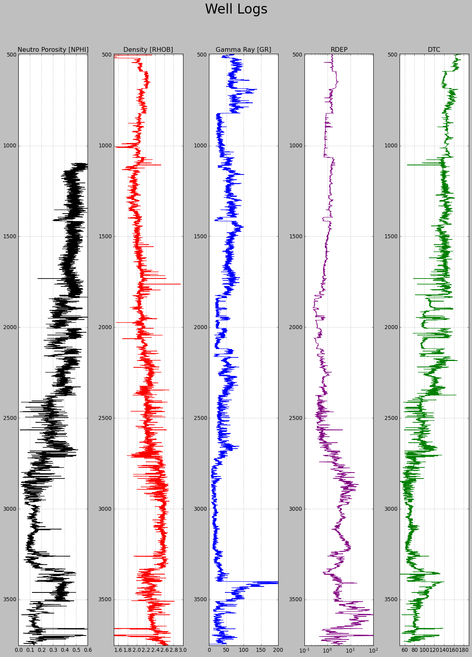
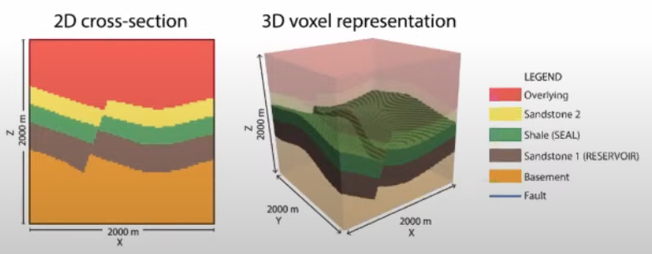


PYTHON for O&G
Lasio
PETROPHYSICS

Slide 12




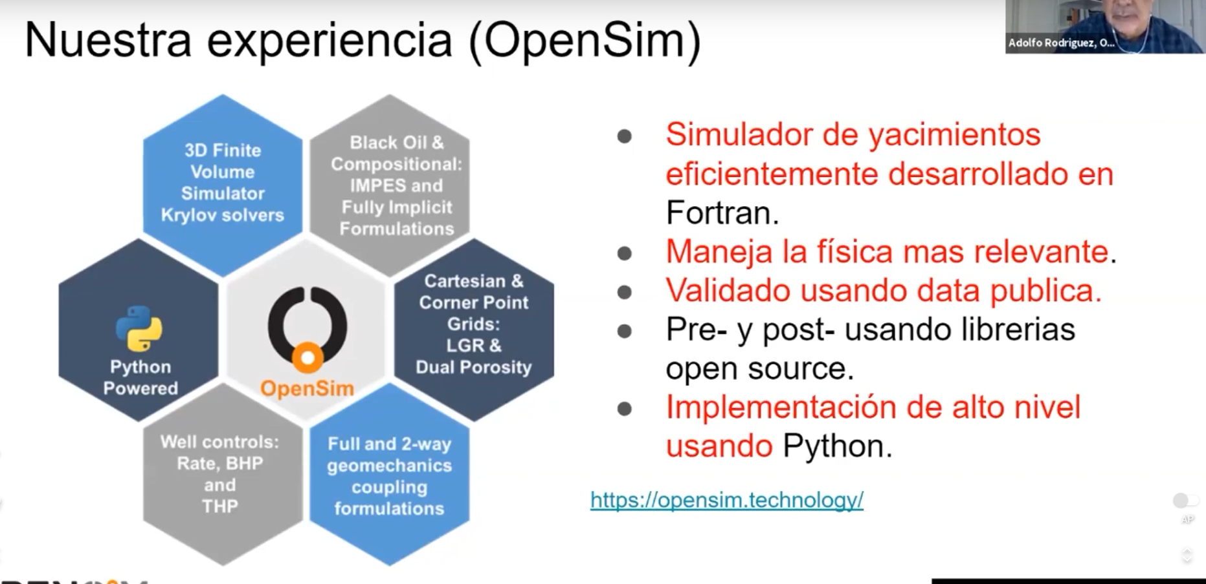

RESERVOIR
Reservoir Engineering Material Balance library
ecl is a package for reading and writing the result files from the Eclipse
Notes:
Libecl is a package for reading and writing the result files from the Eclipse reservoir simulator
Reservoir Engineering Material Balance library

Slide 13

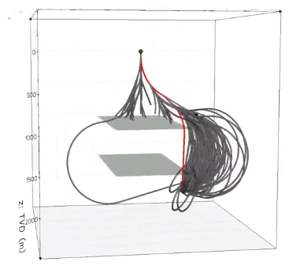
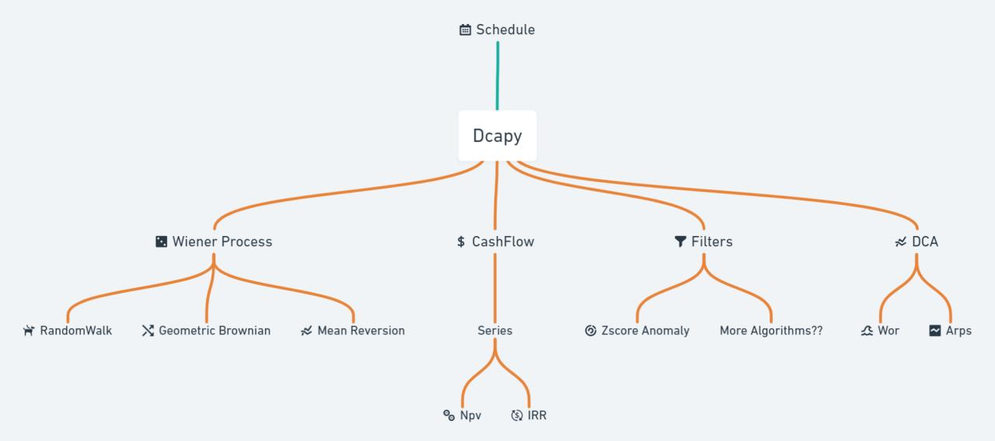
DRILLING
PRODUCTION
Dcapy
Simple production forecast
Cash flow analysis

Slide 14


PEOPLE YOU SHOULD FOLLOW FOR MACHINE LEARNING AND DATA SCIENCE IN OIL & GAS
second
Shahab D. Mohaghegh
Yohanes Nuwara
Andy McDonald
Michael Pyrcz
Ruslan Miftakhov
Hoss Belyadi
Jaiyesh Chahar
Tim D Clarke
Divyanshu Vyas
Alejandro Primera
Santiago Cuervo
Luis Enrique Navarro
Happy Learning!

Slide 15




https://colab.research.google.com/?hl=es

Slide 16
THANKS!
Any questions?

Slide 17



TEAM PRESENTATION
ALEXIS DE LOS RIOS Petroleum Engineer
Blue is the colour of the clear sky and the deep sea
MONTSERRAT BARBA JOB TITLE
Blue is the colour of the clear sky and the deep sea
KEVIN VASQUEZ
Petroleum Engineer | Data Science E.
“Success is the sum of small efforts, repeated day in and day out.”
- Robert Collier

Slide 18

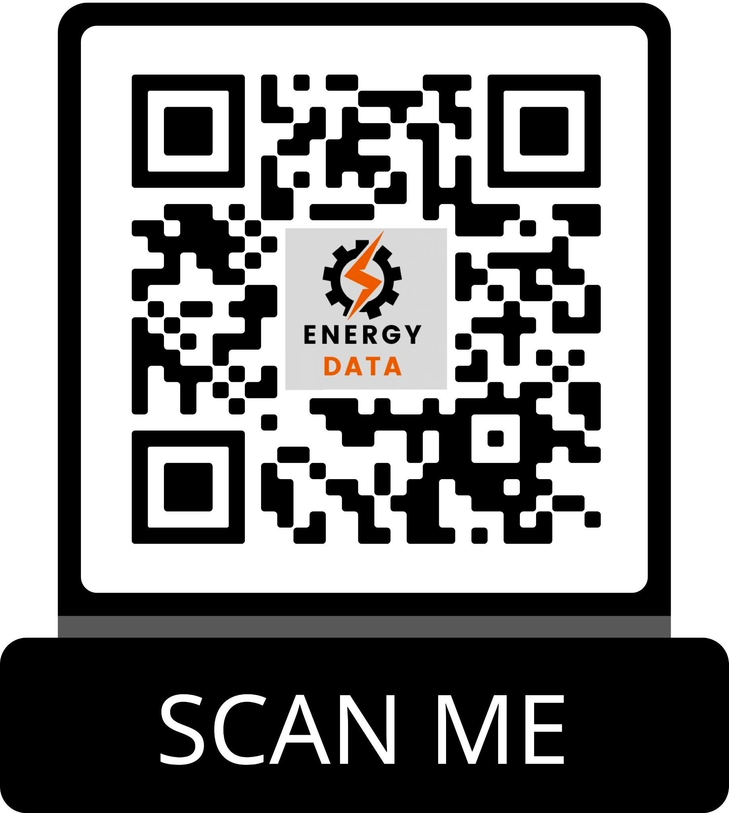
GitHub repository

